Slide 1
Data Mining for business Decisions
How Data Mining has helped/can help Blackwell Electronics
Kevin Burr, Alex Ganevsky, Clark Humphrey & Zachery Wacker
October 2019

Slide 2
What we will cover
Introduction to Data Mining
Recent Analyses Performed:
Determining if customers prefer Acer or Sony - Classification
Sales Potential of New Products – Multiple Regression
Electronidex Acquisition Potential – Market Basket Analysis
Possible Future Applications of Data Mining for Blackwell Electronics

Slide 3
Introduction to data mining
All analysis done using R
Free programming language widely used in data analytics and statistics fields
Has additional “packages” which can be used to enhance its abilities
More info can be found at https://www.r-project.org/
With the help of RStudio
RStudio is an integrated development environment (IDE) for R
Allows for a clean UI and additional QOL improvements while working with R

Slide 4
What we will cover
Introduction to Data Mining
Recent Analyses Performed:
Determining if customers prefer Acer or Sony - Classification
Sales Potential of New Products – Multiple Regression
Electronidex Acquisition Potential – Market Basket Analysis
Possible Future Applications of Data Mining for Blackwell Electronics

Slide 5
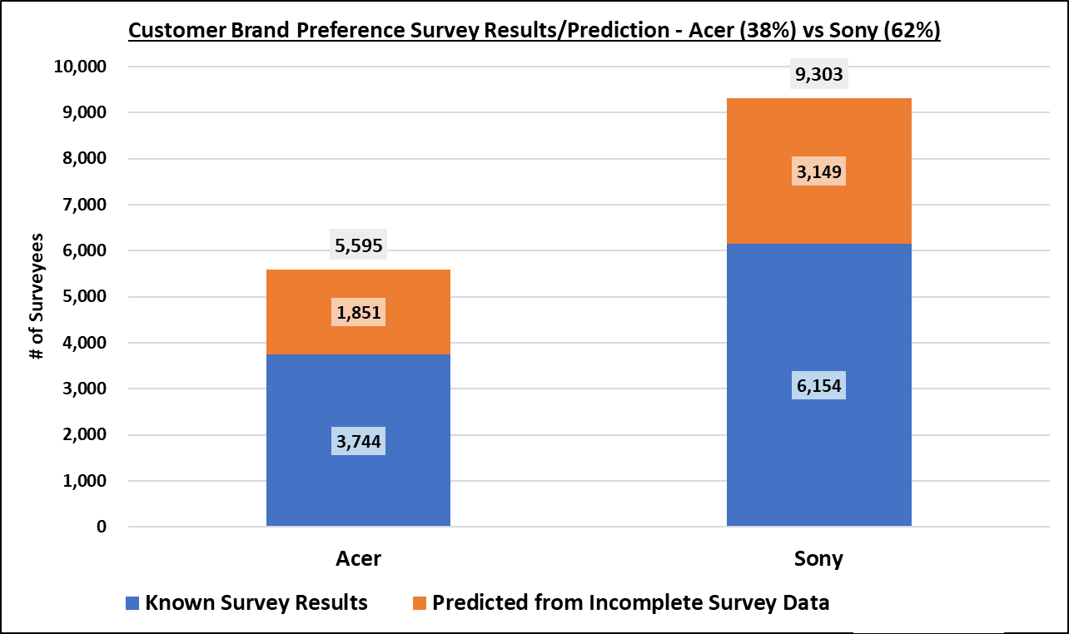
Brand Preference (Acer vs Sony)
14,898 Customer Surveys
Data gathered for salary, age, highest education level, car make, zip code region, credit available, and brand
5,000 or 34% incomplete
Found 1,851 for Acer
Found 3,149 for Sony
Customers Prefer Sony over Acer
62% for Sony
38% for Acer

Slide 6
What we will cover
Introduction to Data Mining
Recent Analyses Performed:
Determining if customers prefer Acer or Sony - Classification
Sales Potential of New Products – Multiple Regression
Electronidex Acquisition Potential – Market Basket Analysis
Possible Future Applications of Data Mining for Blackwell Electronics

Slide 7
Sales Potential of New Products
24 Potential New Products
Sales Focus = 13 Products
Laptops
PCs
Others = 11 Products
Game Consoles, Tablets, Accessories, Software, Printers, Printer Supplies, & Extended Warranties
Netbooks
Smartphones
1. Customer/Service Review Effects on Volume
Correlation on Volume & Product Types
Correlation Plot
High +/- correlation = strong effect
2. Sales Prediction-Multiple Regression Analysis
Caret R Package Algorithms (10 Tested)
Train/Test – 80 current products
Best used on potential new products
Calculate predicted sales by category
All categories just in case

Slide 8
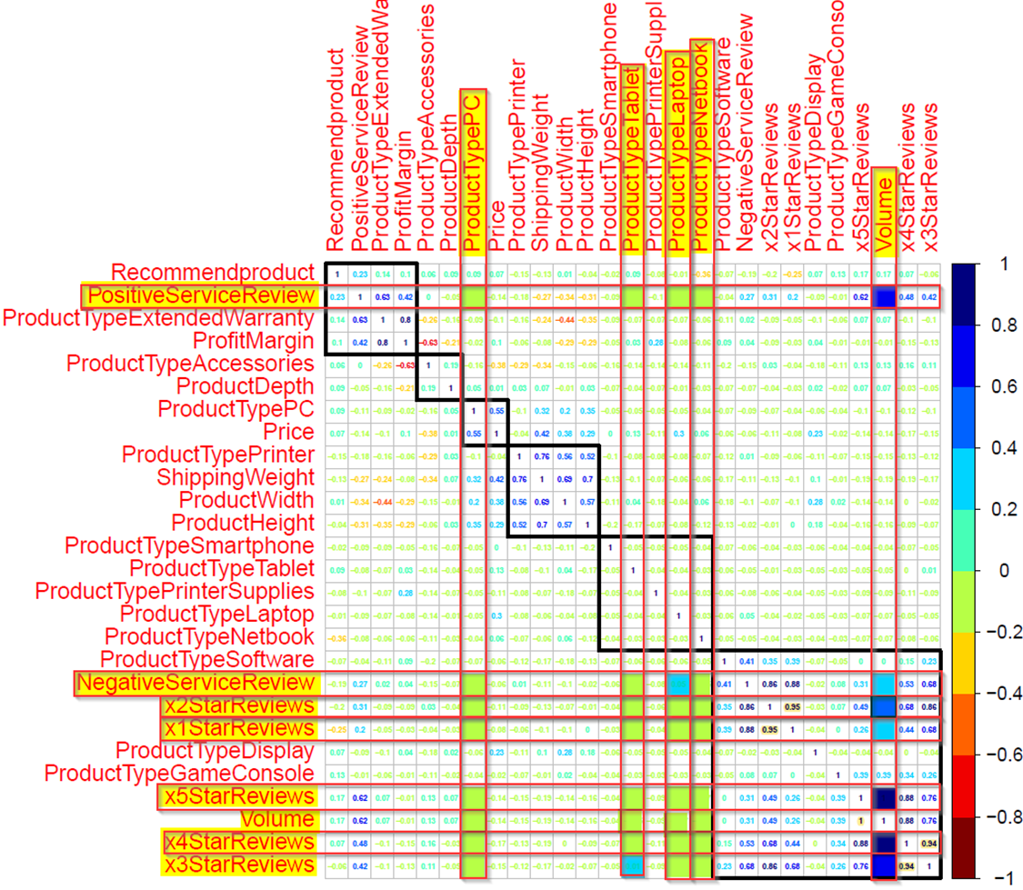
Sales Potential of New Products
Effect of Customer/Service Reviews
Strong Positive Volume Correlation
2-5 Star Customer Reviews
Positive Service Reviews
Weak Positive Correlations
1-Star Customer Reviews
Negative Service Reviews
Product types little to no effect

Slide 9
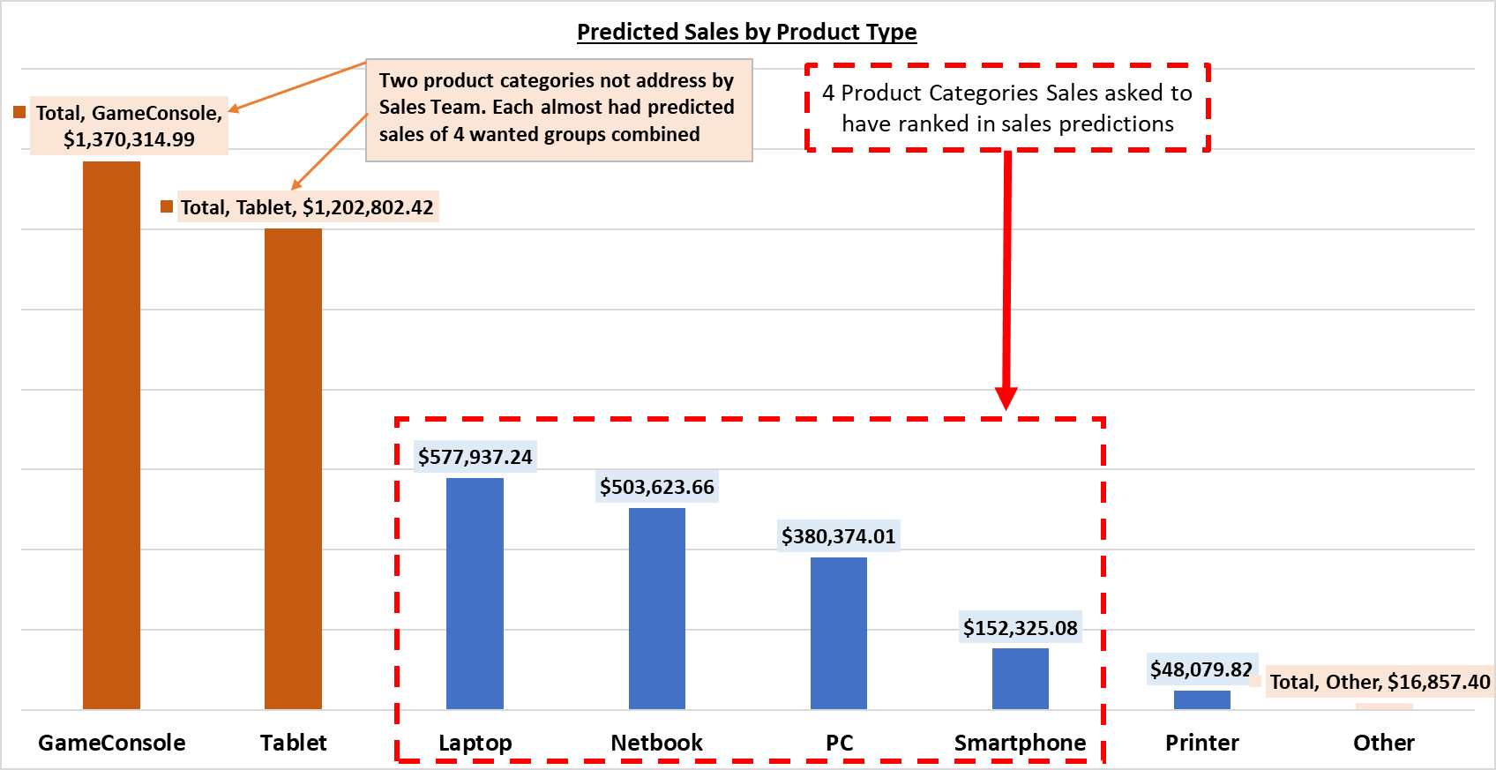
Sales Potential of New Products

Slide 10
What we will cover
Introduction to Data Mining
Recent Analyses Performed:
Determining if customers prefer Acer or Sony - Classification
Sales Potential of New Products – Multiple Regression
Electronidex Acquisition Potential – Market Basket Analysis
Possible Future Applications of Data Mining for Blackwell Electronics

Slide 11
Purchase Electronidex?
Questions
Are there any interesting patterns in Electronidex client transactions?
Would we benefit from acquisition of Electronidex?
Approach
Reviewed 30 days worth of transaction history
Assessed most commonly acquired products
Inferred likely buying patterns for clients
Formulated opinion on acquisition

Slide 12
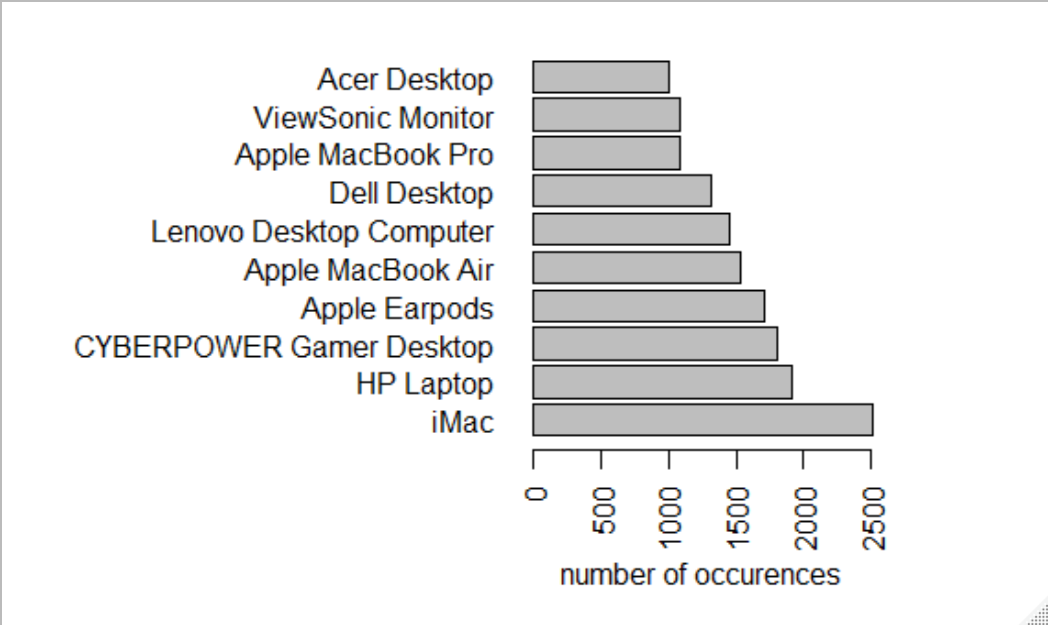
Purchase Electronidex?
1 item: 22%
2 items: 17%
3 items: 13%
Other: 48%

Slide 13
Purchase Electronidex?
iMac OR HO Laptop | Monitor OR Keyboard (49% prob and 2x likelihood)
Non-Apple Laptop OR Desktop + Monitor | Imac (57% prob and 3x likelihood)
More than 1 computer | Monitor + keyboard + computer games (4x likelihood)
iMac | Keyboard
iMac | Apple Related Accessories
Common Purchase Themes
Monitor + Desktop + Desktop/Laptop
Leads to iMac or HP Laptop
Student Purchase
Monitor + MS Office 2016 Student
Leads to iMac
Family & Student Package Discounts
Cross Selling Extended Warranties
Buy Electronidex? = Maybe
Would like to see in order to verify:
Gap Analysis (Products)
Financial & Industry Analysis

Slide 14
What we will cover
Introduction to Data Mining
Recent Analyses Performed:
Determining if customers prefer Acer or Sony - Classification
Sales Potential of New Products – Multiple Regression
Electronidex Acquisition Potential – Market Basket Analysis
Possible Future Applications of Data Mining for Blackwell Electronics

Slide 15
Possible Future Applications
More work with Surveys!
Sample a small, relevant subset of our customers to make inferences on the bigger population.
With proper planning we can potentially learn some value information at a cheaper price
Product Recommendations
Cross selling is a very simple way to increase revenue, the trick comes in doing it right

Slide 16

Questions

Slide 17
Appendix – Acer vs Sony

Slide 18
C5.0 Variable Importance
Rank | Variable | % of Data Effected
1 | Age | 100.00%
2 | Salary | 100.00%
3 | Education Level | 19.94%
4 | Zip Code | 0.00%
5 | Car Owned | 0.00%
6 | Available Credit | 0.00%

Slide 19
Appendix – New Sales Potential

Slide 20
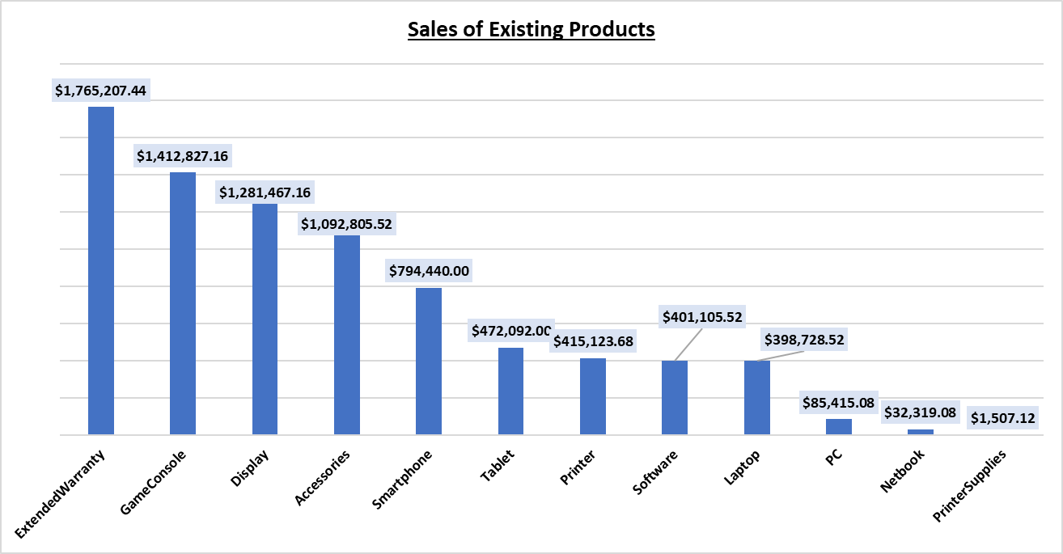
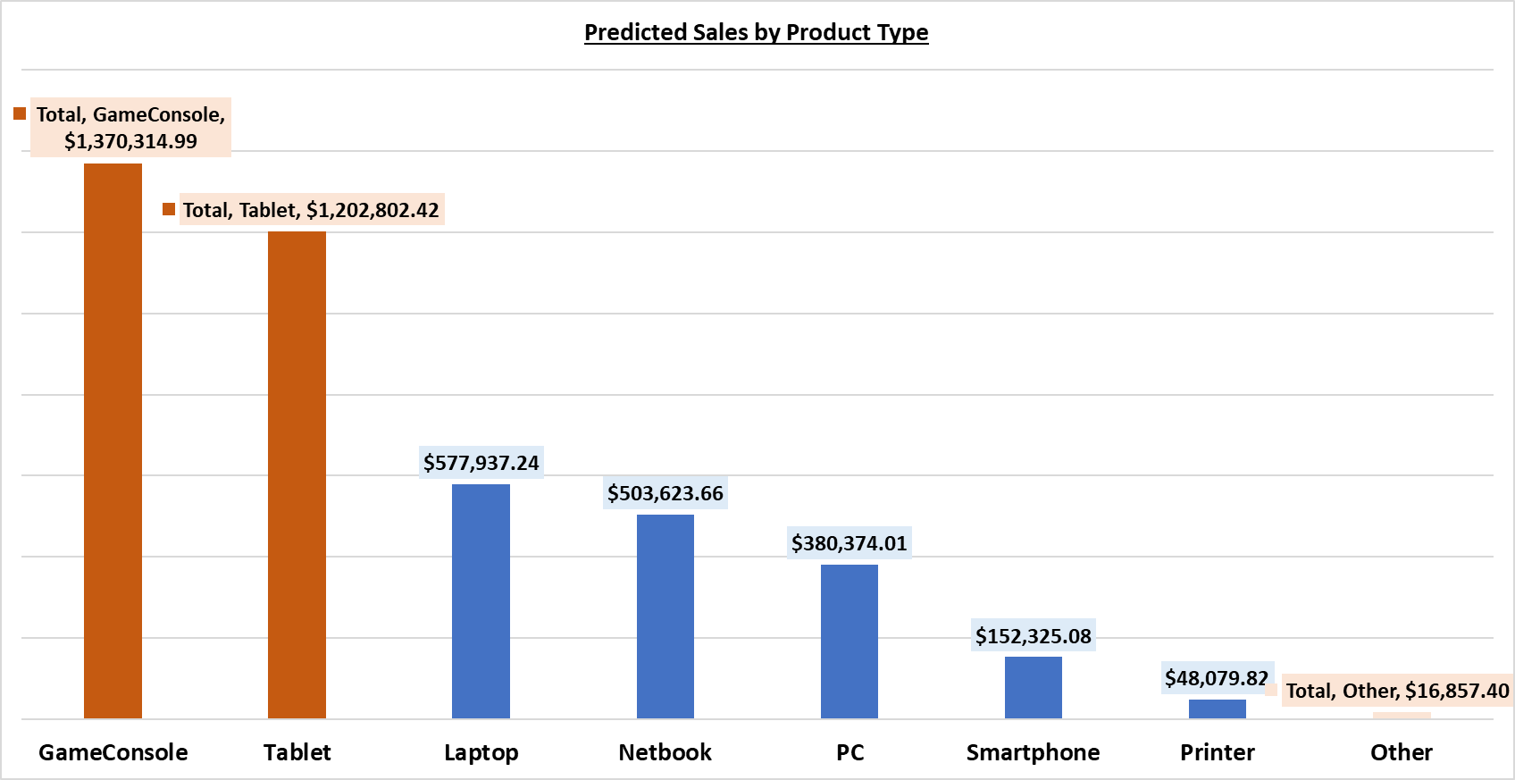
Existing Vs New Forecast
Exist Products (80)
New Products (17)

Slide 21
Appendix – Electronidex?

Slide 22
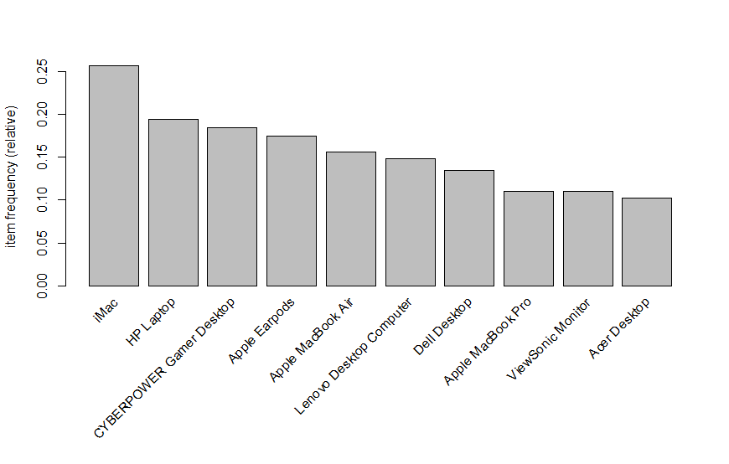
Electronidex’s Top 10 Items

Slide 23
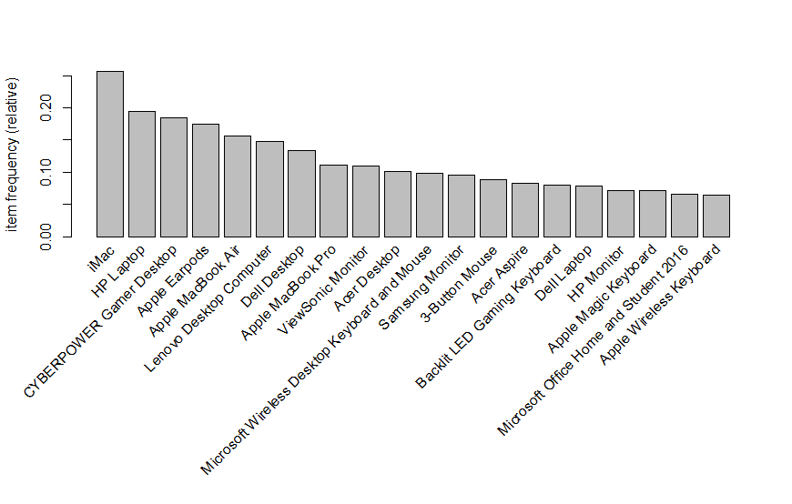
Electronidex’s Top 20 Items

Slide 24
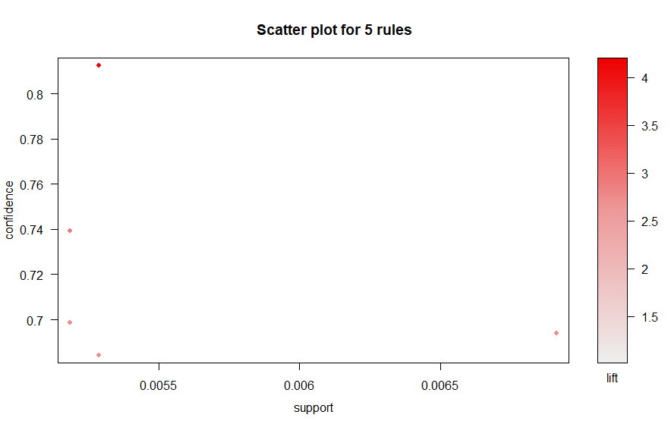
Market Basket Rule Plot

Slide 25
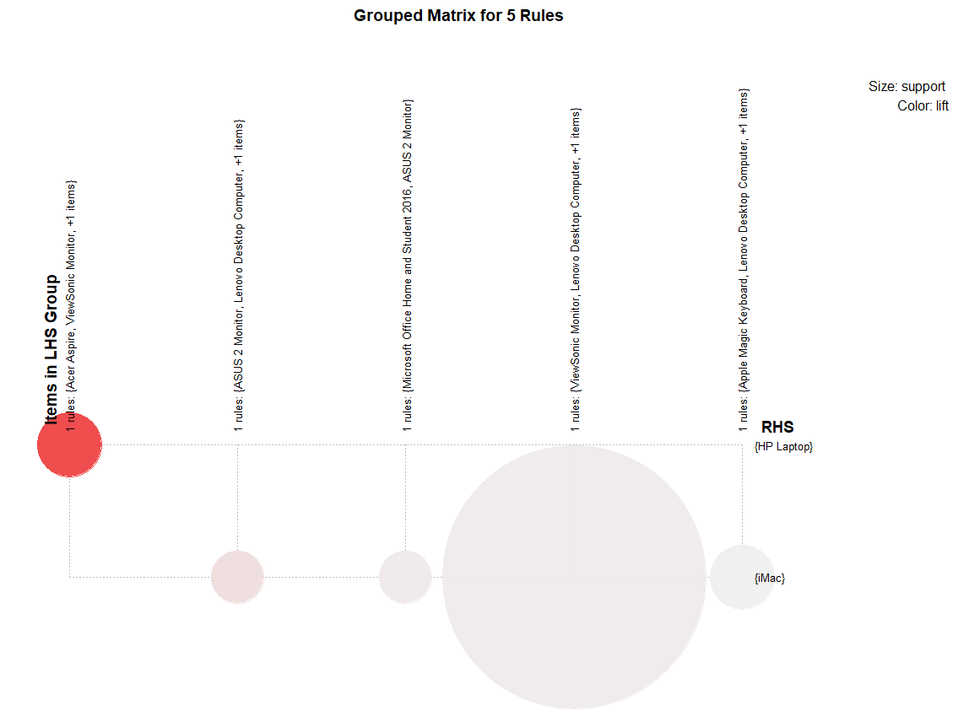
Rules Grouped Matrix

